Slide 1
Route to Market simulation
Go-to market digital twin to accelerate revenue growth through optimization of sales, marketing, business development and partner resources
November 2021

Slide 2

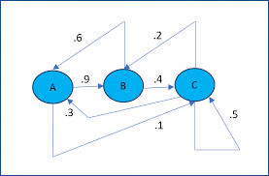
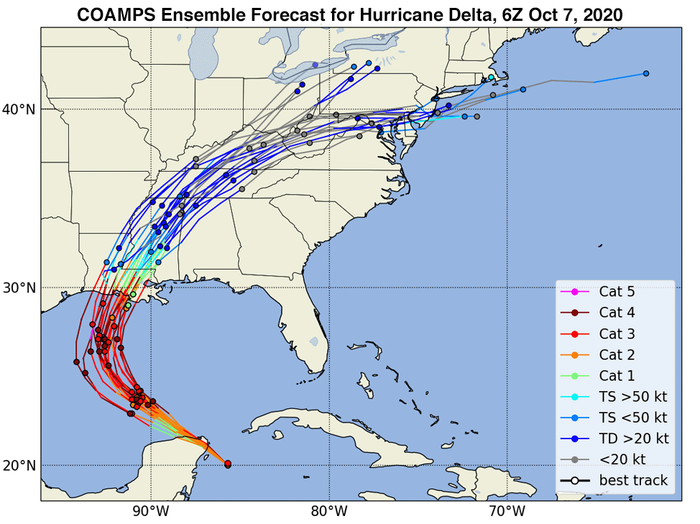
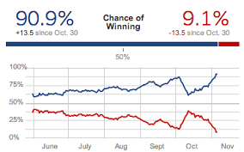
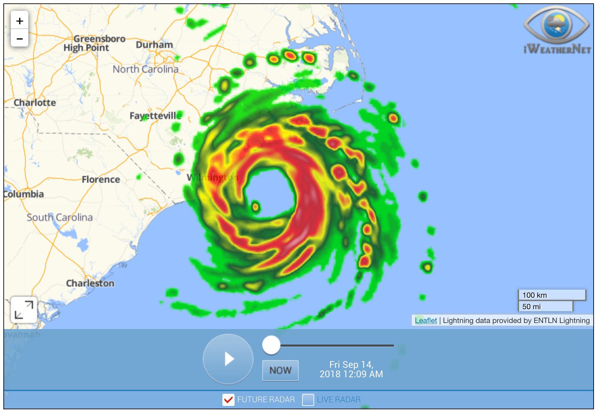
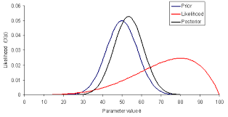

Conceptual Overview > Route to Market Simulation
21st century statistics and data science
Sophisticated modeling and simulation
Revolutionary visualization, animation and user experience
Notes:
538 for route to market forecasting, planning and actions

Slide 3
Route to Market Simulation Use Cases
 | Machine Learning | Artificial Intelligence | Cluster Analysis | Multi-variate regression | Monte Carlo Simulation
Acquisition synergies
b. New product launch
c. Pipeline root cause analysis
d. Competitive and market insights / positioning
e. Business partner ecosystem
f. Lead generation and opportunity prioritization
g. Seller productivity
h. Market conditioning and business development
i. Pipeline recovery actions, impact and timing
j. Constraining factors / R2M optimization
c. Pipeline root cause analysis
a. Acquisition synergies
Strategic
d. Competitive insights
b. New product launch
e. Business partner ecosystem
j. Constraining factors and R2M Optimization
f. Lead generation and opportunity prioritization
g. Seller productivity
i. Current quarter / next quarter actions
h. Market conditioning and demand generation
Tactical
Current Quarter
Annual Planning
Strategic Planning (2 -5 years)

Slide 4
Go-to market digital twin overview
Identify tactics most impactful at addressing pipeline challenges
Understand expected outcomes from marketing tactics based on simple framing
Identify pipeline dynamics with greatest potential for business impact
Identify constraining factors
Determine root cause issues impacting growth
gtm / tactic insights
MVP Model
Forecast impact of proposed go-to market model on pipeline, signings and revenue growth
Understand expected outcomes from sales and marketing tactics based on proposed resource levels and historical tactic productivity
scenario analysis
pipeline root cause
pipeline visualization and simulation
client agenda builder
RTM mix optimizer
Build scenarios based on mapping tactics to growth objectives
Model key GTM outcomes associated with different marketing / sales mix scenarios
Evaluate trade-offs between growth, margin and cash objectives
Identify sales, marketing, and business development actions that align to clients’ key issues
growth blueprint
Forecast pipeline dynamics, throughput, and revenue impact based on historical pipeline velocity metrics and defined scenarios
Overlay incremental actions on current projections to assess overall impact on pipeline and signings

Slide 5
Scenario Analysis Use Cases
1
2
3
Market Conditioning
Seller Productivity
Business Partner Ecosystem
What is the impact on a 10% increase in validated leads based on a 30% increase in awareness and preference in target accounts?
What is the impact on won pipeline of 30% increase in validated leads from digital demand programs
What sales communities are most productive at identifying new leads and opportunities?
What are opportunity attributes that have the highest correlation with sales productivity?
What is the expected impact of incremental sales resources across the sales cycle
How many business partners are required to support target revenue growth
What are opportunity or business partner attributes that drive highest and lowest business partner sales productivity?
What is the impact of increased demand generation programs and lead passing to business partners?
4
5
6
Competitive Insights
Lead generation and opportunity prioritization
New Product Launch
What opportunity attributes has the highest correlation with win and loss probability vs. key competitors
What are the opportunity attributes that have the highest impact on pipeline progression velocity and win rate?
What are number of new leads, lead progression rates, identified opportunities, opportunity progression and win rates required to attain growth targets for a new product?
How many resources are required and what is the optimal route-to-market mix

Slide 6
Key Design Points
Simulation Design and Structure
Pipeline forecasting model simulation reflects how opportunities progress through the sales cycle
Pipeline acts as a predictable system that can be understood and modeled through a set of historical pipeline metrics and statistics - identified leads - lead progression statistics - win rates
Stochastic modeling provides a forward-looking view of pipeline through use of pipeline statistics calculated through time series analysis
Key to understanding system is to develop a new set of pipeline velocity statistics to support advanced modeling and scenario analysis
New leads
stall
Engage
close
progress
revert
Qualify
stall
close
progress
revert
Design
stall
close
progress
stall
revert
Propose
close
progress
revert
Negotiate
Closing
Win
Loss

Slide 7
Environmental Intelligence Suite Growth Blueprint
IDEA SCENARIO
Scenario
General Manager has committed to CEO and SVPs that they will launch a new product suite and grow it to $500M in three years. The product management team has a product roadmap and development is engaged but launching the product is just the beginning. The go-to market model needs to be designed as an integrated system inclusive of considerations across marketing, business development, sales and business partners.
This requires a deep understanding of sales, marketing, offering and competitive issues that will impact the sales and marketing pipeline. The insights are in the existing and historical pipeline data but are difficult to uncover because the right pipeline velocity metrics are not being tracked. Further, the interdependencies across product, marketing, sales, business partners and delivery require a sophisticated approach to modeling the resources and productivity required across the go-to market model. A go-to market digital twin will significantly improve the understanding of scale and timing required to ensure a successful product launch.
New Product Launch Scenario
Sales, marketing and product teams need to understand go-to market model requirements to support a successful product launch even before the product is generally available
Notes:
Optimizing marketing mix to support sales and business development requires deep understanding of sales pipeline dynamics and constraining factors
robust data exists to inform marketing strategy, business development tactics and sales effectiveness
Better data than ever on marketing tactic effectiveness, sales productivity and opportunity pipeline; however, unstructured format makes it challenging to incorporate into planning
Shape of your pipeline and the constraining factors will lead you to different actions
90 day action plans need to be adapted to reflect changing pipeline challenges

Slide 8
Pipeline velocity metrics power forecasting engine
Key Design Points
Average Weekly Pipeline Velocity Metrics
Stochastic model based on historical pipeline analysis - mean - standard deviation
Historical statistics calculated using weekly comparison of pipeline at opportunity level
Projections based on actual current with simulation of weekly activity using standard normal statistics
Weekly projections summed to monthly and quarterly forecasts
New leads
stall
88
5
ID 100
close
5
progress
7
43
revert
VL 50
stall
close
3
3
progress
4
19
revert
QL 25
stall
close
4
2
progress
2
stall
revert
AG 10
close
progress
revert
WN 5

Slide 9
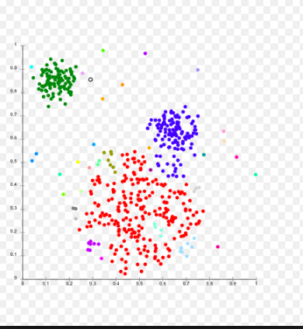
Go-to market digital twin visualizations - I
Cluster analysis @ L30 (Identified leads)
Cluster analysis @ L30 (Validated Opp progression)
Cluster based on opportunity attributes (e.g. OI Source, OO Owner type, Opportunity value $, Marketing tactic)
Menu to select portfolio / offerings , IMT, and date range
Velocity metrics calculated based on time series data (every unique opportunity should have a set of velocity metrics tagged to the opportunity
ID > Val lead velocity
VAL > QUAL velocity
New leads / month
Days in Sales Stage (VAL)

Slide 10
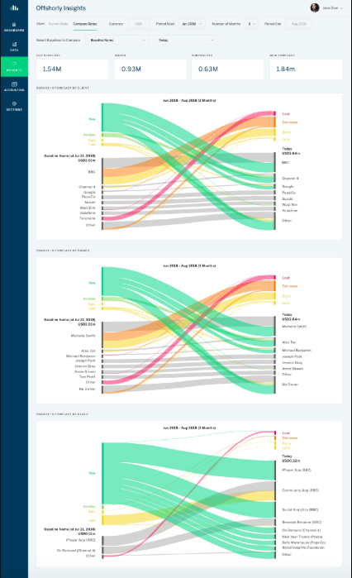
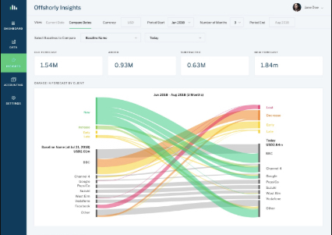
Go-to market digital twin visualizations - II
http://christophjanz.blogspot.com/2016/06/a-better-way-to-visualize-pipeline.html
Notes:
Challenge of looking at total pipeline when leads are constantly coming in, going out, and buried underneath a lot of poor opportunities

Slide 11
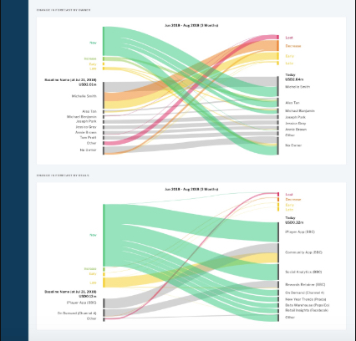
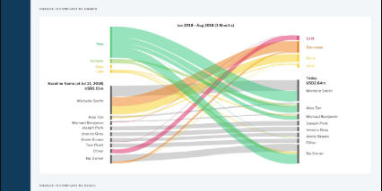
Go-to market digital twin visualizations III

Slide 12

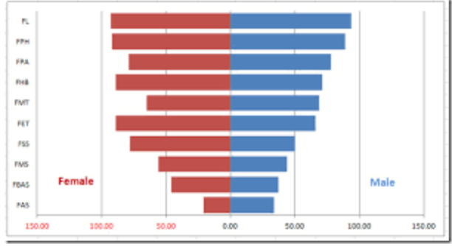
Go-to market digital twin visualizations - IV
Pipeline Simulation ‘Weather Map’
‘Pipeline in Motion’ visualization of monte carlo simulation
Shows leads being added, opportunities moving through the pipeline, and results of won / loss opportunities
Tracks TCV and Revenue from wins
Ability to pause simulation and move forward and back on timeline
Wins
Losses
# $M.X
# $M.X
Pipeline by stage
Select time series (quarterly, monthly, weekly)
https://weather.com/weather/radar/interactive/l/ce156be39e720764d95b9362dc9e67241b3904c7e72708c662295db026dd4984

Slide 13
pyMC3
Purpose
PyMC3 is a probabilistic programming package for Python that allows users to fit Bayesian models using a variety of numerical methods, most notably Markov chain Monte Carlo (MCMC) and variational inference (VI). Its flexibility and extensibility make it applicable to a large suite of problems. Along with core model specification and fitting functionality, PyMC3 includes functionality for summarizing output and for model diagnostics.
Features
PyMC3 strives to make Bayesian modeling as simple and painless as possible, allowing users to focus on their scientific problem, rather than on the methods used to solve it. Here is a partial list of its features:
Modern methods for fitting Bayesian models, including MCMC and VI.
Includes a large suite of well-documented statistical distributions.
Uses Theano as the computational backend, allowing for fast expression evaluation, automatic gradient calculation, and GPU computing.
Built-in support for Gaussian process modeling.
Model summarization and plotting.
Model checking and convergence detection.
Extensible: easily incorporates custom step methods and unusual probability distributions.
Bayesian models can be embedded in larger programs, and results can be analyzed with the full power of Python.
What’s new in version 3
The third major version of PyMC has benefitted from being re-written from scratch. Substantial improvements in the user interface and performance have resulted from this. While PyMC2 relied on Fortran extensions (via f2py) for most of the computational heavy-lifting, PyMC3 leverages Theano, a library from the Montréal Institute for Learning Algorithms (MILA), for array-based expression evaluation, to perform its computation. What this provides, above all else, is fast automatic differentiation, which is at the heart of the gradient-based sampling and optimization methods currently providing inference for probabilistic programming.
Major changes from previous versions:
New flexible object model and syntax (not backward-compatible with PyMC2).
Gradient-based MCMC methods, including Hamiltonian Monte Carlo (HMC), the No U-turn Sampler (NUTS), and Stein Variational Gradient Descent.
Variational inference methods, including automatic differentiation variational inference (ADVI) and operator variational inference (OPVI).
An interface for easy formula-based specification of generalized linear models (GLM).
Elliptical slice sampling.
Specialized distributions for representing time series.
A library of Jupyter notebooks that provide case studies and fully developed usage examples.
Much more!
While the addition of Theano adds a level of complexity to the development of PyMC, fundamentally altering how the underlying computation is performed, we have worked hard to maintain the elegant simplicity of the original PyMC model specification syntax.
https://docs.pymc.io/

Slide 14
MVP Pipeline Simulation Sprint Plan
Single geography simulation with historical pipeline metrics
Expand simulation to additional geographies with ‘what-if’ scenario inputs
Expand product mix and channel mix scenarios
Construct top-down model
Single geography model > input variables
Review process for data cleansing and calculation of pipeline velocity statistics
Write python code to automate data cleansing and calculate pipeline statistics
Calculate historical pipeline velocity statistics using weekly compare of 13 – 26 weeks of historical data
Join pymc3 community and develop foundational understanding of
Create simple top-down forecasting monte carlo model for North America (Current Course and Speed; monthly pipeline report 2022 - 2024); Excel or pymc3 based
Understand fundamentals of pipeline sales stages and progression paths Add Opportunity Identification channel resource and productivity assumptions
Add Opportunity Ownership channel resource and productivity assumptions
Conduct opportunity attribute analysis and develop pipeline velocity profiles at category level “traunches”
Develop MVP simulation visualization and dashboard
Pymc3 based simulation
Test model with multiple growth scenarios
Add additional dashboard and simulation visualization views
Add signings to revenue waterfall calculation
Develop global view to summarize across geographies
Create opportunity level pipeline simulation profiles (statistics for moving through the sales stages based on opportunity attributes)
Include timeline for market launch of additional EIS products
Develop set of global variables to provide scenario analysis (e.g. Marketing resources, marketing budget, sales resources, number of business partners, etc
Calculate resource requirements to deliver forecasted revenue
Team Skills
Pipeline Analytics
Python Developer
Data Scientist
Visualization SME
Statistics / Monte Carlo
Date TBD
Date TBD
Date TBD
Date TBD
Date TBD

Slide 15
Appendix

Slide 16
Functional Requirements
Infer model structure
Visualizations and comparisons
Scenario analysis
Sales stages
Product structure
Sales roles
Probability distributions
Pipeline history
Pipeline by stage and - product family - sales channel - region - OI Source
Projection vs target
Weekly, monthly, quarterly trends
New leads by OI Source
Opportunity validation velocity / progression rate
Opportunity qualification velocity / progression rate
Current course and speed
Strategic opportunity scenarios
Improvement scenarios (percentage increase in pipeline metrics)
Weekly model update
Simulation and forecasting
Forecast Improvements
T₀ Portfolio states
Weekly pipeline history states
Forecast errors and updated probability distributions
Weekly updated forecast
More frequent, simpler text updates on deal status
Synthesis from multiple models
Cluster analysis on key deal characteristics
New client, upsell, renewal

Slide 17
Weekly pipeline changes
Define forecasting model structure
Compare weekly snapshots and identify changes
Import current pipeline master file with opportunity level detail records
Import previous week pipeline master file with opportunity level detail records
Scan for changes and flag opportunities with an update
Identify new opportunities by comparing Opportunity. Number / Detail Key vs. prior week file.
If Oppt Number / Detail key is new then store for weekly visualization data
Update statistics for new leads by type
Update Pipeline Current State visualization
Analyze total number of pipeline records
Determine foundational model using product structure where at least 100 pipeline records exist for each product.
Determine whether a second variable can be included in the forecasting model based on number of pipeline records.
Determine whether sales channel or region can be incorporated into the forecasting model.
Determine whether opportunity identification source can be added to new leads forecasts

Slide 18
Route-to-market mix, sales execution, and marketing plans frequently need to be adapted within the context of market conditions, resource constraints and sales challenges
Incremental actions analysis
Sales, marketing and offering teams experiencing chronic revenue growth and pipeline challenges that recognize the need for remediation plans and model expected impact
IDEA SCENARIO
Scenario
General Manager is looking at projected growth figures (current quarter and next quarter pipeline) and realizes that current course and speed will not result in target growth. They need to develop a plan of incremental sales, marketing and business development actions that can be implemented over the next 90 days.
This requires a deep understanding of sales, marketing, offering and competitive issues impacting the pipeline. Not enough new leads? deals not progressing quickly enough? don't have access to the right decision makers. These insights will drive the marketing actions required. Once identified, marketing leaders need to be able to size the expected impact of the actions on the business
Notes:
Optimizing marketing mix to support sales and business development requires deep understanding of sales pipeline dynamics and constraining factors
robust data exists to inform marketing strategy, business development tactics and sales effectiveness
Better data than ever on marketing tactic effectiveness, sales productivity and opportunity pipeline; however, unstructured format makes it challenging to incorporate into planning
Shape of your pipeline and the constraining factors will lead you to different actions
90 day action plans need to be adapted to reflect changing pipeline challenges

Slide 19

Scenario B: Root cause analysis
1
2
3
Pipeline analysis and visualization
Analyze where gaps exist
Identify root cause issues
need more leads
Equation Variables (metrics)
Drivers
VL > QL progression
Aligned to Client Priorities/Needs
Competitive Offering / Portfolio
Growth Segments / Top Accounts
Competitive Price
Win Rate
Compelling Offerings / Value Proposition
Awareness / Preference
Signings Growth
Healthy Lead Stream
Marketing Leads
S&D Alignment
Alliances
Early Stage Business Development
Strong Lead Progression
Seller Coverage
Delivery Capacity / Utilization
# of days to close
Seller Productivity
4
Determine tactics to address
5
6
Seller Skills
Frame tactics and size impact
Drive account team execution
To: IOT Leaders
From: General Manager
RE: Pipeline > New Event
Reach 100
Response 30
Leads 10
Pipeline $30M
“let’s run an event!”

Slide 20
Pipeline growth algorithm and diagnostic metrics
Drivers
Diagnostic Metrics
Equation Variables (metrics)
Market Size / Growth
Relative Market Share
Aligned to Client Priorities / Needs
Competitive Offering / Portfolio
Growth Segments
Core/Invest Account Growth
Competitive Price
VP$M Growth Initiatives
Won-Loss Analysis
Compelling Value Proposition / Differentiation
Client Satisfaction (NPS)
References / Success Stories
GBS banking partner/AP
feedback
Awareness / Preference
Industry Analyst Rankings
Marketing Leads
VL$M Top 5 Tactics
Revenue Growth
Healthy Lead Stream
Industry Alignment
Validated Leads from S&D / Pipeline
New Leads / Month (last 12 months)
ID > VL Progression velocity
Business Partner leads
BVA-BVI conversion rate
Early Stage Business Development
Non-competitive proposals / Win Rate
Whitespace Accounts
Future Quarter Pipeline growth rate
Pull forward opportunities
Seller Coverage
OO / Seller
Number of Sellers / Trend
Strong Lead Progression
Seller Productivity
Pipeline / Seller
Progression / Seller
Win Rate (quarterly)
VL > QL Progression velocity
Progression /Closing Tactics
Downloads / Seller Feedback
Seller Competency Ratings

Slide 21
Strategic Pipeline Insights Visualizations - I
Market Size / Growth
Relative Market Share
Aligned to Client Priorities / Needs
Awareness / Preference
Offering NPS
Competitive Offering / Portfolio
Marketing Leads
Core/Invest Account Growth
Healthy Lead Stream
VP$M Growth Initiatives
Growth Segments
Industry Sellers
Won-Loss Analysis
Competitive Price
Business Partner leads
GBS banking partner/AP
feedback
New Leads / Month (last 12 months)
ID > VL Progression velocity
Compelling Value Proposition / Differentiation
Revenue Growth
Business Development
Industry Analyst Rankings
Whitespace Accounts
VL$M Top 5 Tactics
Validated Leads from S&D / Pipeline
BVA-BVI conversion rate
Seller Coverage
Non-competitive proposals / Win Rate
Support NPS
Future Quarter Pipeline growth rate
Sales Mgmt
Seller Productivity
Experience NPS
OO / Seller
Number of Sellers / Trend
Client Experience
Strong Lead Progression
Progression Tactics
Pull forward opportunities
Pipeline / Seller
Progression / Seller
Digital Experience
Client Events
Win Rate (quarterly)
VL > QL Progression velocity
Downloads / Seller Feedback
Automatically color code based on pipeline metrics vs. average or
Trial Conversion
Strategic deals
Seller Competency Ratings
Special Incentives

Slide 22
AI can help understand expected impact of marketing mix and tactics on pipeline and signings
Rich data exists to inform route-to-market initiatives
Explosion of data on effectiveness of business development and marketing actions thorough improvements in CRM and marketing operations systems
Optimization across sales, marketing, and business development needs to be driven by a deep understanding of sales dynamics, pipeline challenges and constraining factors
Campaign and tactic effectiveness data is under-utilized to optimize marketing and business development efforts
Predictive analytics can be applied through scenario analysis to model impact of changes in mix - expected top line impact of existing pipeline - expected top line impact of new leads that will be created at ‘current course and speed’ - scenario analysis for incremental marketing and business development tactics

